Slide 1

Translating Cultures: A Neural Approach to English-Hindi Translation
Team 9:
Vamshi Krishna Madhavan
Akshay Manoj
Nikita Anil Yadav

Slide 2

AGENDA
Project Overview
Data Strategy
Insights Unveiled
Challenges
Q & A

Slide 3
Project OVERVIEW
STUDY OBJECTIVE
Develop a machine translation system for English-Hindi and Hindi-English using mBART and mT5-small models
Achieve effective translation with a focus on quality and contextual preservation
Conduct a comparative analysis of mBART and mT5 models to evaluate translation accuracy and contextual handling

Slide 4

Data Strategy

Slide 5
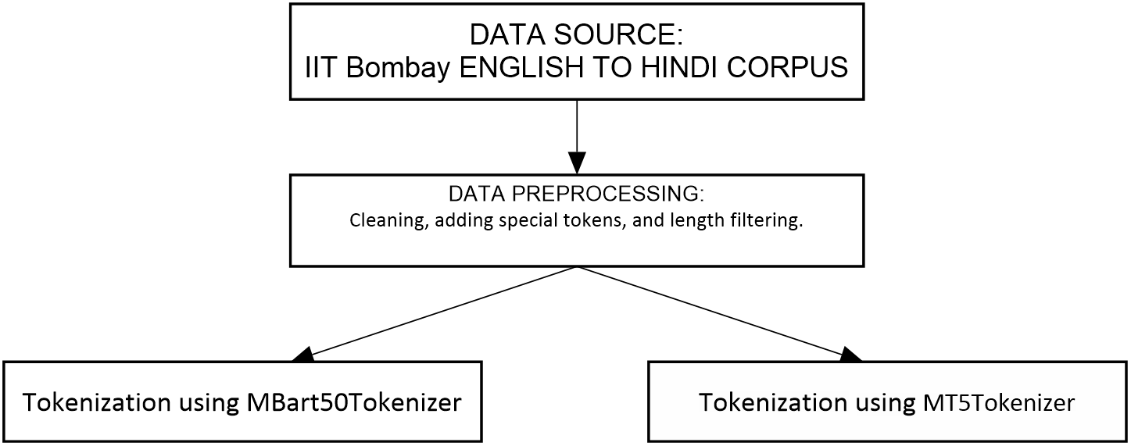

Slide 6

Insights Unveiled

Slide 7
Keys for Models & Metrics
mBART and mT5:
Multilingual BART model trained having “denoising” objective, on large dataset mainly for translation purpose
Multilingual T5 model trained with “text-to-text” framework in multiple languages to perform variety of NLP tasks like summarization, Q&A, etc.
BERT Score:
BERT score evaluates sematic similarity using mBART embeddings to assess contextual alignment

Slide 8
mBART Models
Configuration
Source Data :
English Embeddings
Target Data :
Hindi Embeddings
Training
LR Scheduler : Linear
Gradient Clipping
Epochs 3
Evaluation
Translation quality & performance using BERT Score
English to Hindi Model
Configuration
Source Data :
Hindi Embeddings
Target Data :
English Embeddings
Training
LR Scheduler : Linear
Gradient Clipping
Epochs 3
Evaluation
Translation quality & performance using BERT Score
Hindi to English Model

Slide 9
mT5-Small English to Hindi Model
Configuration
Source Data :
English Embeddings
Target Data :
Hindi Embeddings
Training
LR Scheduler : Cosine
Batch Size : 16
Max steps : 40000
Bf16 : True
Evaluation
Translation quality & performance using BERT Score

Slide 10

EVALUATION METRICS
BERT Score:
Precision: 95.5%
Recall: 92%
F1: 93.7%
BERT Score:
Precision: 98.4%
Recall: 98.9%
F1: 98.7%
BERT Score:
Precision: 77.3%
Recall: 77.5%
F1: 77.2%
mBART English-to-Hindi
mBART Hindi-to-English
mT5 English-to-Hindi

Slide 11
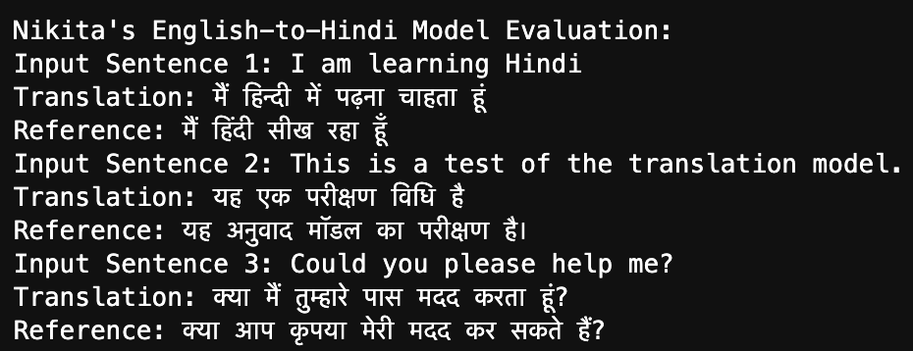
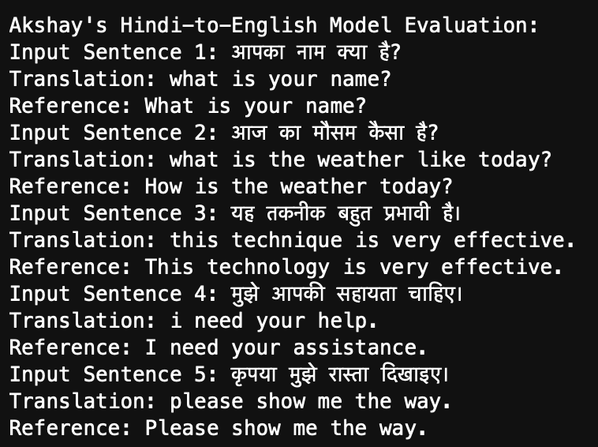
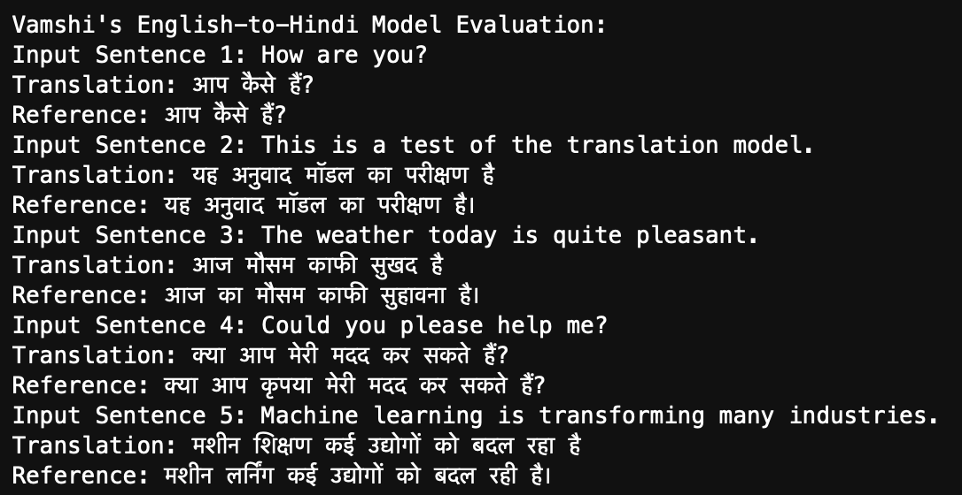
SAMPLE OUTPUTS

Slide 12

Challenges

Slide 13
List of Challenges:
High Validation Loss and Generalization Issues
mT5 model, training loss – 0.0 and validation loss – Nan values
Data Quality and Inconsistencies (Translation Quality, Errors in Translation, Contextual Differences)
Resource Intensity and Training Stability (slower convergence or incomplete training, impacting the quality of the final model)
Evaluation Challenges (Evaluating translation quality between English and Hindi may not fully capture contextual and grammatical accuracy)
Bf16=True, config param in training arguments
Notes:
Domain-specific terms (e.g., medical, legal) may lead to translation errors as models were pre-trained on general language - backup

Slide 14

Q & A

Slide 15

THANK YOU

